Slide 1
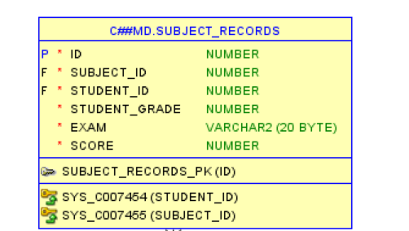
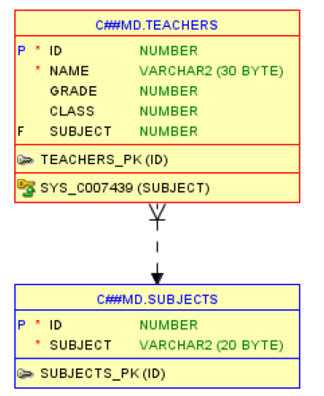
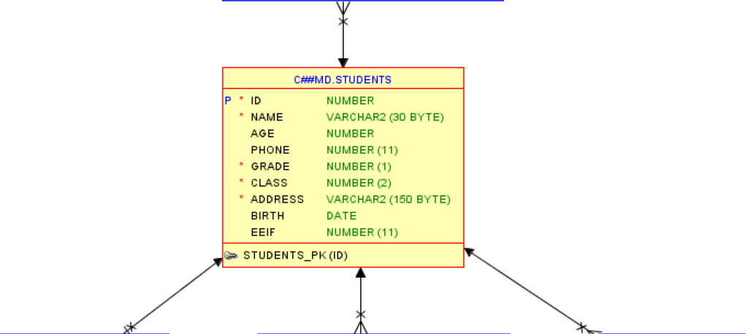
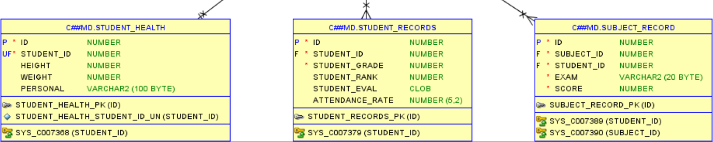
중심 테이블 : students
student_health : students 1:N 관계
student_records : students 1:N 관계
subjects : subject_record N:1 관계
subjects : teachers N:1 관계
subject_record : students N:1 관계
Subject_record : subjects N:1 관계
student_parents : students 1:N 관계
teachers : subjects N:1 관계

